Slide 1

Department of Electronics & Telecommunication Engineering
UG Project Presentation
Cyber Shield: Securing Websites with Embedded Electronic Ecosystem
Academic Guide:
Dr S.G Shivaprasad Yadav
(Associate Professor, Dept. of ETE, RIT)
Student Name & USN:
Aryan Singh (1MS20ET011)
Chaitra (1MS20ET014)
Chandan Kumar (1MS20ET015)
Pranayak Uniyal (1MS20ET035)

Slide 2
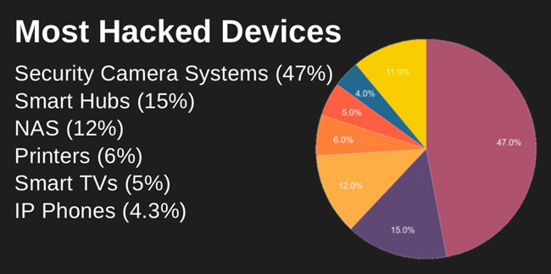
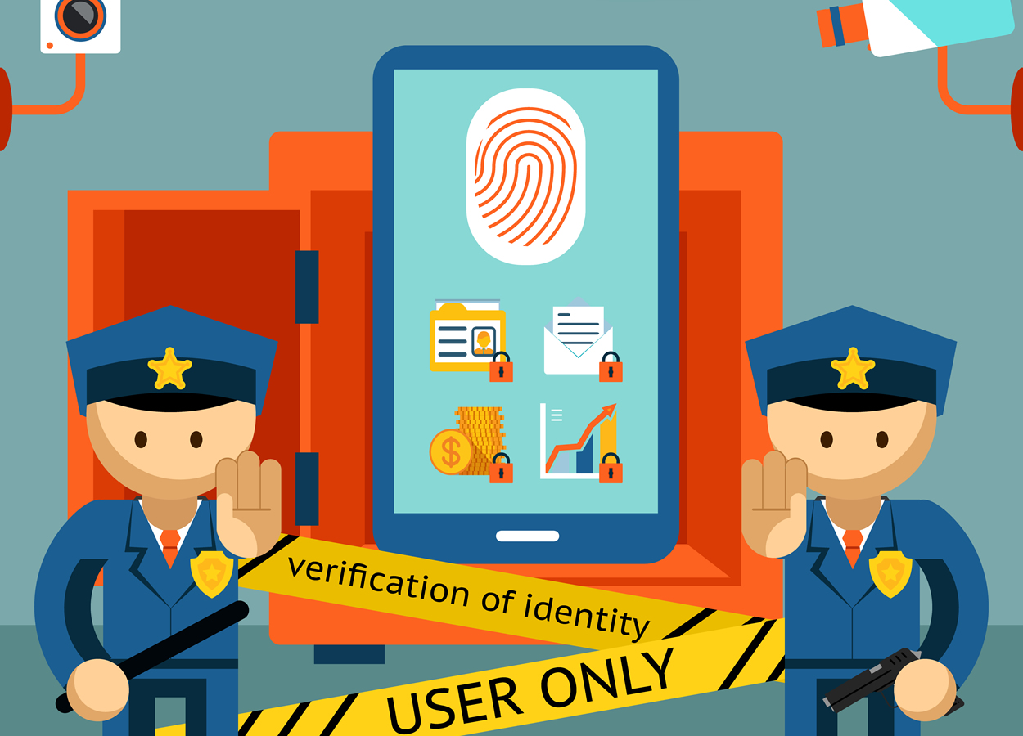
AIM:
The goal of this project is to create a device using Raspberry Pi 4 that helps website administrators and developers find and fix security issues on their websites more easily. The aim is to make websites safer by identifying potential problems before they can be exploited by hackers.
Problem Statement:
Securing data and implementing robust cybersecurity measures are of paramount importance in today's digital age. Our project aims to identify those critical issues or flaws that could be used by ill-intentioned people to exploit them. This system doesn’t only find the flaws but also creates a detailed report of critical level and measures to be taken to fix them.

Slide 3

OBJECTIVES:
To conduct a comprehensive review of existing literature related to web application security, vulnerability scanning tools, and cybersecurity methodologies.
To define the specific requirements and design specifications for the Cyber Shield project based on the insights gained from the literature review.
To create a functional block diagram that illustrates the key components and interactions within the Cyber Shield hardware and software system.
To develop the individual blocks identified in the functional block diagram, including the Raspberry Pi 4, LCD display, USB hub, and the vulnerability scanning tools.
To integrate the individual blocks developed in the previous step and establish seamless interfaces between hardware and software components.
To implement and test wireless communication capabilities within the Cyber Shield system, ensuring effective data transfer and interaction between the Raspberry Pi and other components.

Slide 4
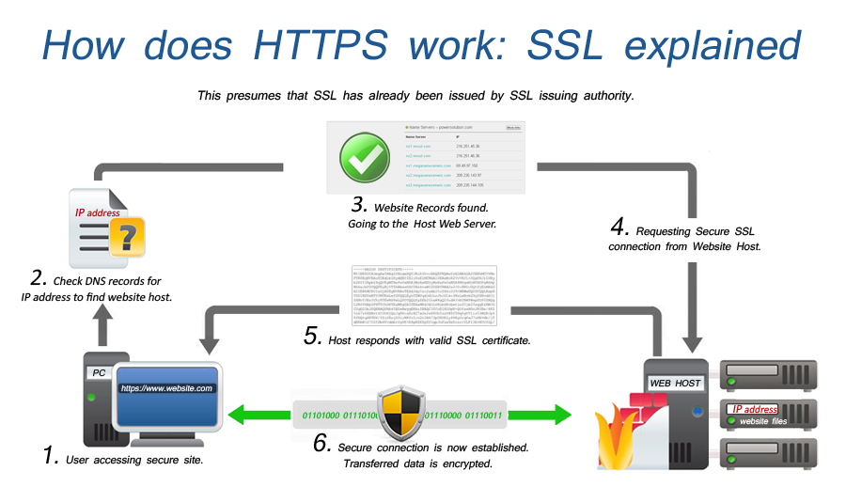
METHODOLOGY:
Project Planning and Scope Definition: Specific vulnerabilities were defined to be addressed, project objectives were set, and the hardware and software requirements were planned.
1
Research and Learning: A comprehensive understanding of the Raspberry Pi 4, Python 3 libraries, and the vulnerabilities targeted by the scanning tools was gained.
2
Environment Setup: The Raspberry Pi 4 was configured with necessary dependencies, and vulnerability scanning tools were installed and set up for seamless integration.
3
Design and Architecture: The structure of the terminal application was strategically planned, a user-friendly interface was created, and a cohesive framework for integrating various security tools was designed.
4
Coding and Implementation: The terminal application was developed using Python 3, and renowned security tools were integrated. Functions for input validation, website scanning, and detailed report generation were implemented.
5
Testing: Rigorous testing, including unit testing for individual functions and integration testing for seamless interactions between tools, was conducted. The application was validated on diverse websites for accuracy.
6
Error Handling and Logging: Robust error handling mechanisms were implemented to gracefully manage exceptions. Logging was set up to record any issues or errors during the scanning process.
This Photo by Unknown Author is licensed under CC BY-NC

Slide 5
User Interface (UI) Enhancement: Enhance the user interface for a user-friendly experience. Add informative prompts, progress bars, and user instructions for effective interaction.
Security Measures: Ensure the terminal application is secure and free from vulnerabilities. Implement measures to protect user data and sensitive information.
Documentation: Create detailed documentation on using the terminal application, vulnerability scanning processes, tools used, and their integration.
Optimization: Identify potential bottlenecks and optimize the application for speed and efficiency. Explore ways to reduce scanning time and resource usage.
Beta Testing and Feedback: Conduct beta testing with a selected group of users, gather feedback, and use insights to improve the application, addressing any identified areas for enhancement or bug fixing.
Finalization and Deployment: Address any issues found during beta testing, package the terminal application for easy installation, and make it available for download or distribution to the target audience.
Maintenance and Updates: Plan for regular maintenance, ensuring the application stays up-to-date. Monitor and update tools as new versions or security patches are released. Consider legal and ethical implications of vulnerability scanning and ensure proper authorization.

Slide 6

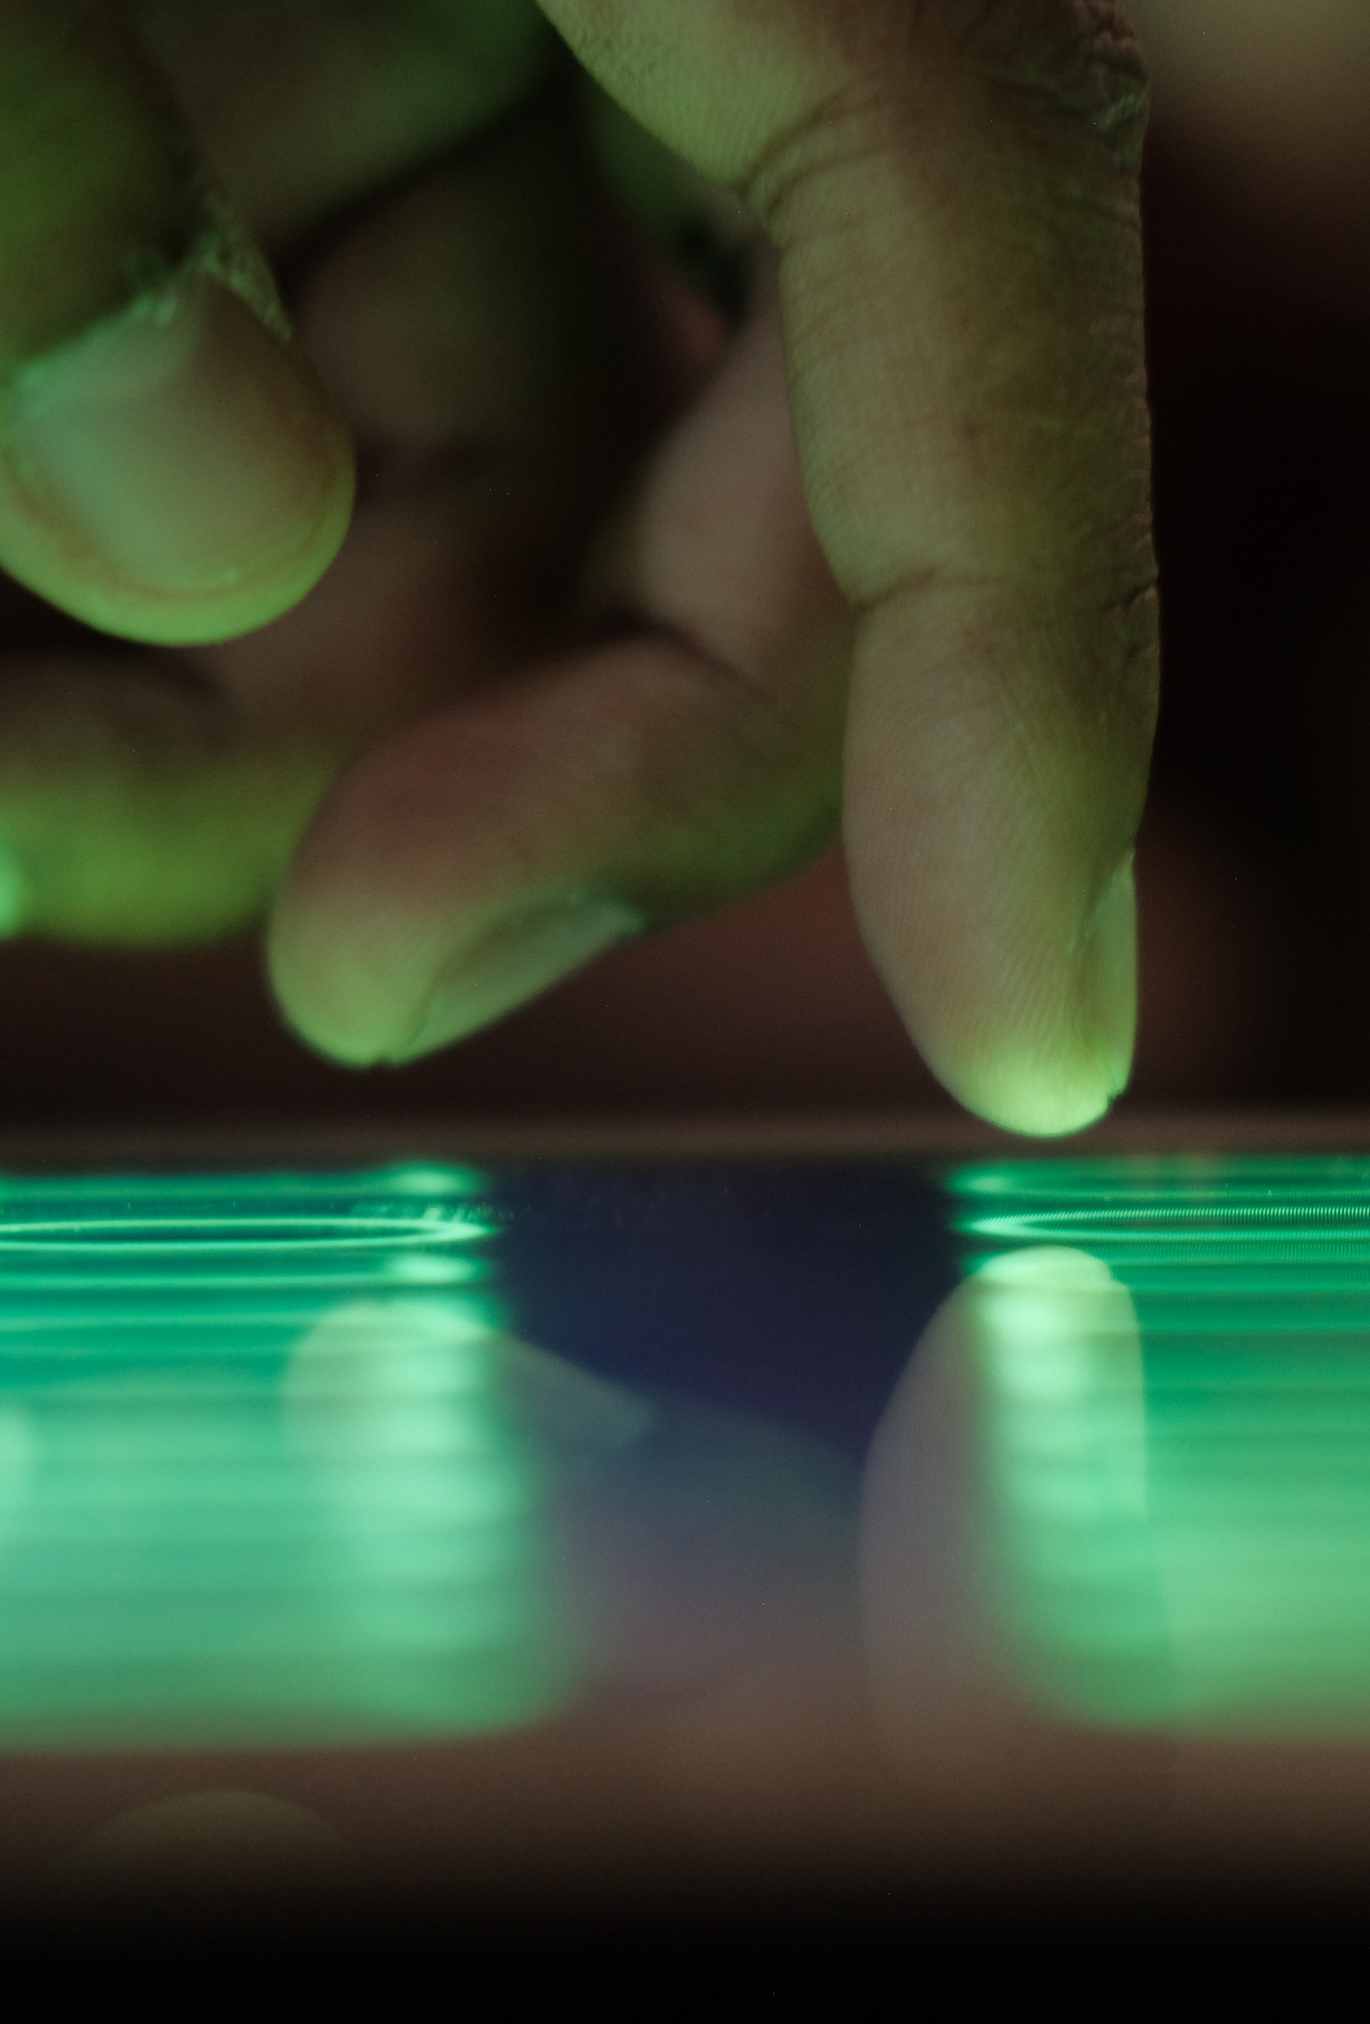
INTRODUCTION:
In an era defined by digital connectivity, web-based platforms have become integral to our daily lives, transforming communication, commerce, and information access. However, this increasing reliance on the internet has exposed web applications to a growing threat landscape, making them susceptible to malicious actors seeking to exploit vulnerabilities. Cyberattacks, data breaches, and security incidents have become prevalent, necessitating robust web application security measures.
Addressing these challenges, our project introduces an innovative hardware device centred around the Raspberry Pi 4, a powerful single-board computer. At its core is a sophisticated terminal application designed to streamline the identification and assessment of vulnerabilities in websites. Unlike traditional approaches using separate security tools, our solution consolidates a selection of renowned tools into a unified framework, enhancing the efficiency of vulnerability assessment.

Slide 7
Literature Review
1. A STUDY OF CYBER SECURITY CHALLENGES AND ITS EMERGNING TRENDS ON LATEST TECHNOLOGIES
Rising cyber crimes pose a significant threat, prompting governments and companies to implement measures in a rapidly evolving technological landscape.
Cloud adoption, Advanced Persistent Threats, mobile network vulnerabilities, and IPv6 transition contribute to changing cybersecurity dynamics.
Social media's widespread use becomes a cyber threat hotspot, demanding vigilance in balancing publicity with safeguarding personal information.
Access control, password security, authentication, malware scanners, firewalls, and antivirus software are vital measures to fortify cybersecurity defenses.
Responsible internet use is crucial, encompassing guidelines like avoiding cyberbullying, respecting copyrights, and safeguarding personal information to enhance overall cybersecurity.

Slide 8
LITERATURE REVIEW
2. BUGS IN OUR POCKETS: THE RISKS OF CLIENT-SIDE SCANNING
CSS, a shift from server-side scanning, raises concerns as it compromises user privacy, challenges security, and lacks clear crime prevention efficacy.
CSS introduces security and privacy risks, questioning the effectiveness of detecting targeted content. The potential for abuse and lack of user control are highlighted.
Unlike server-side scanning, CSS operates on user devices, blurring the line between private and shared data. The paper evaluates the shift's impact on security and privacy.
The paper examines CSS technologies, including perceptual hashing and machine learning. It outlines the operational flows for server-side and client-side scanning, emphasizing potential vulnerabilities.
Moving scanning to the client introduces new threats, from on-device attacks to vulnerabilities in the back-end infrastructure. The paper proposes design principles, emphasizing simplicity, least privilege, and open design to mitigate risks.

Slide 9
LITERATURE Review
3. A COMPREHENSIVE REVIEW STUDY OF CYBER-ATTACKS AND CYBER SECURITY; EMERGING TRENDS AND RECENT DEVELOPMENTS
Cyberspace is a pivotal power source, challenging traditional notions of power distribution among governments.
National security now extends beyond military concerns, encompassing citizens' quality of life as a crucial dimension.
Cyber threats defy traditional geographical constraints, complicating identification and response strategies for governments.
Cyber threats are sporadic, multidimensional, and pose high levels of damage to sensitive networks, necessitating unprecedented cooperation.
Beyond governments, individuals and companies are susceptible to cyber threats, requiring collective efforts and cooperation for effective mitigation.

Slide 10
LITERATURE Review
4. Research Paper on Cyber Security
Cybersecurity's future is dynamic and vast, intertwined with digital advancements. It's poised to become a pivotal concern in various realms.
Anticipates swift and unpredictable changes in cybersecurity trends. Societies often underestimate the speed of transformative shifts in the digital landscape.
Envisions cybersecurity as the preeminent challenge of the internet era, surpassing mere technological concerns, akin to existential challenges like climate change.
Acknowledges that foreseeing risks is easier than envisioning opportunities in the ever-evolving internet environment. Urges exploration of possibilities rather than focusing solely on mitigating risks.
Encourages readers to contemplate their stance amid the upcoming cybersecurity landscape. Advocates for proactive strategies, emphasizing the need for continuous research and adaptive policies.

Slide 11
LITERATURE Review :
5. Cyber security: Study on Attack, Threat, Vulnerability
Investigates cyber infrastructure vulnerabilities, emphasizing hardware, software, networks, and cyber intrusions' impact on systems and data.
Addresses the quick escalation of cybercrime, attributing it to factors like network intrusions, cyber theft, and the proliferation of cyber threats.
Offers a comprehensive definition of cyber security, emphasizing its role in safeguarding information, countering cyber theft, and discussing preventive measures against attacks.
Highlights the vulnerability rooted in human behaviour and psychology, emphasizing the importance of organizational education to mitigate cyber threats effectively.
Concludes with recommendations for preventive measures and solutions, acknowledging technology's role while underscoring the need for global cooperation and continued research in cyber security.

Slide 12
LITERATURE Review :
6. A Review Paper on Cyber-Security
Examines the escalating concerns regarding cybersecurity due to increased data flow across global networks and the surge in cybercrimes.
Discusses the development of "Cyber Law" to combat criminal activities on the internet, emphasizing its role in addressing cybercrimes in India.
Traces the history of cybercrime, from the first computer theft in 1973 to notable incidents like the 2017 WannaCry ransomware attack and subsequent developments.
Explores various cyber threats, including malware attacks (viruses, Trojans, worms, botnets), phishing, password attacks, distributed denial-of-service (DDoS) attacks, and man-in-the-middle attacks.
Highlights essential steps to protect against cyber threats, including software updates, social media management, anti-virus usage, strong password practices, cautious online behaviour, and awareness of different cyber-attacks.

Slide 13
Summary of Literature Review:
1. Global Concern for Rising Cyber Threats :-
→All papers highlight the universal concern surrounding the escalation of cyber threats, emphasizing the need for comprehensive and collaborative cybersecurity measures.
2. Technological Evolution's Impact on Security :-
→Recognition of the profound impact of technological advancements on cybersecurity, with discussions on trends, rapid changes, and the inclusive nature of threats across various domains.
3. Human Factor in Cybersecurity :-
→ Consistent acknowledgment of the human element's vulnerability, underscoring the importance of education, awareness, and responsible internet use to enhance overall cybersecurity.

Slide 14
Summary of Literature Review:
4. Legal Frameworks and Cyber Laws :-
→ Emphasis on the evolution of cyber laws and legal frameworks to address and combat cybercrimes, showcasing the importance of legislative measures in cybersecurity efforts.
5. Diverse Cyber Threat Landscape :-
→ Recognition of the multifaceted nature of cyber threats, encompassing social media vulnerabilities, client-side scanning risks, geographical shifts in threats, and the historical perspective on cybercrime.
6. Proactive Strategies and Collaboration :-
→ A consistent call for proactive strategies, continuous research, and global cooperation to effectively tackle the dynamic and evolving landscape of cybersecurity challenges.

Slide 15
Algorithm analysis :
map (Network Mapper):
Efficiency Index: 8/10
Time Complexity: O(N), where N is the number of hosts or services being scanned.
Space Complexity: O(1) for most basic scans.
DNSRecon:
Efficiency Index: 7/10
Time Complexity: O(N), where N is the number of DNS records or subdomains.
Space Complexity: O(N) for storing DNS information.
WAFW00F (Web Application Firewall Detection Tool):
Efficiency Index: 6/10
Time Complexity: O(1) for basic analysis of HTTP responses.
Space Complexity: O(1) for storing WAF detection results.

Slide 16
Algorithm analysis :
Uniscan:
Efficiency Index: 7/10
Time Complexity: O(M * N), where M is the number of web pages and N is the number of vulnerabilities checked.
Space Complexity: O(N) for storing scan results.
SSLyze:
Efficiency Index: 8/10
Time Complexity: O(N), where N is the number of SSL/TLS configurations to check.
Space Complexity: O(1) for basic analysis.
Nikto:
Efficiency Index: 6/10
Time Complexity: O(M * N), where M is the number of tests performed and N is the number of potential vulnerabilities checked.
Space Complexity: O(N) for storing scan results.

Slide 17
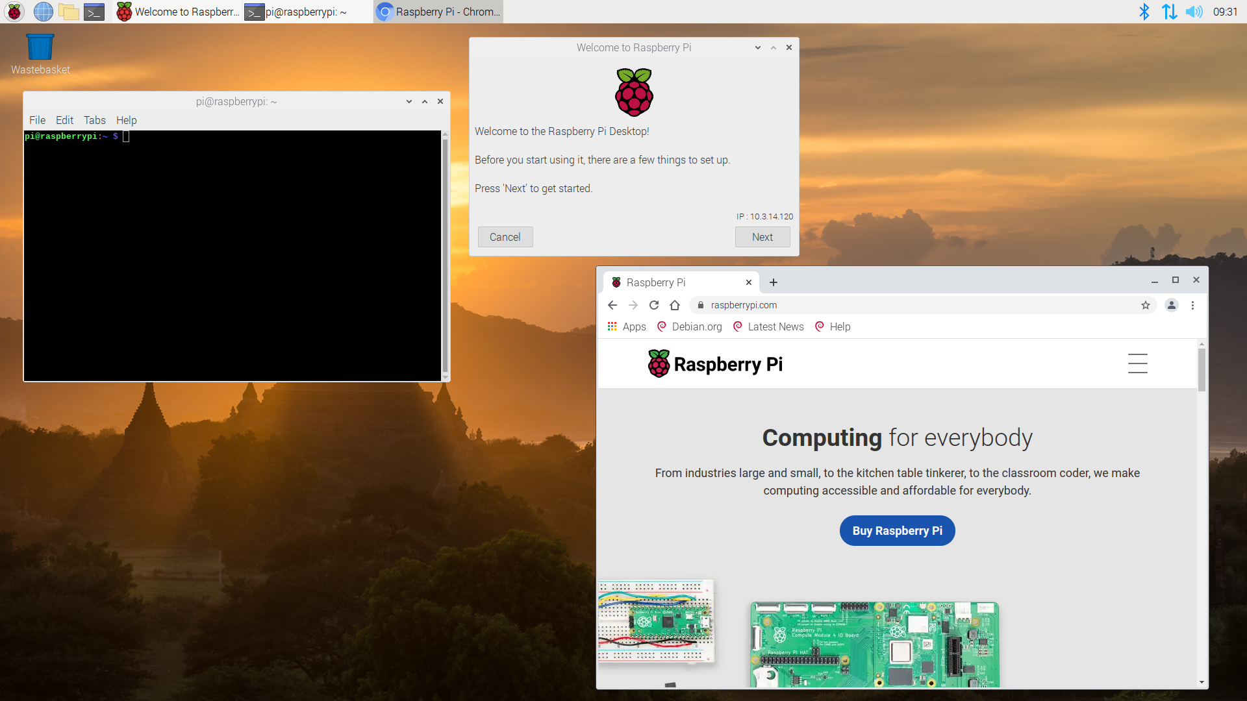
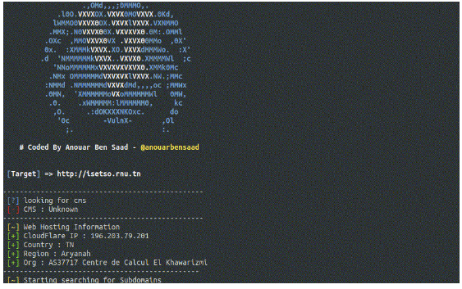
Software REQUIREMENTS
Operating System: - Raspberry Pi OS (Raspbian) or any compatible OS for Raspberry Pi.
Programming Language: - Python 3 for developing the terminal application.
Python Libraries and Modules: - Required libraries for interacting with cybersecurity tools (subprocess, os, requests, etc.).
Vulnerability Scanning Tools: - nmap, dnsrecon, wafw00f, uniscan, sslyze, fierce, lbd, theharvester, amass, nikto, and others.
Additional Libraries for Tool Interactions: - Any libraries needed for seamless integration of vulnerability scanning tools.

Slide 18
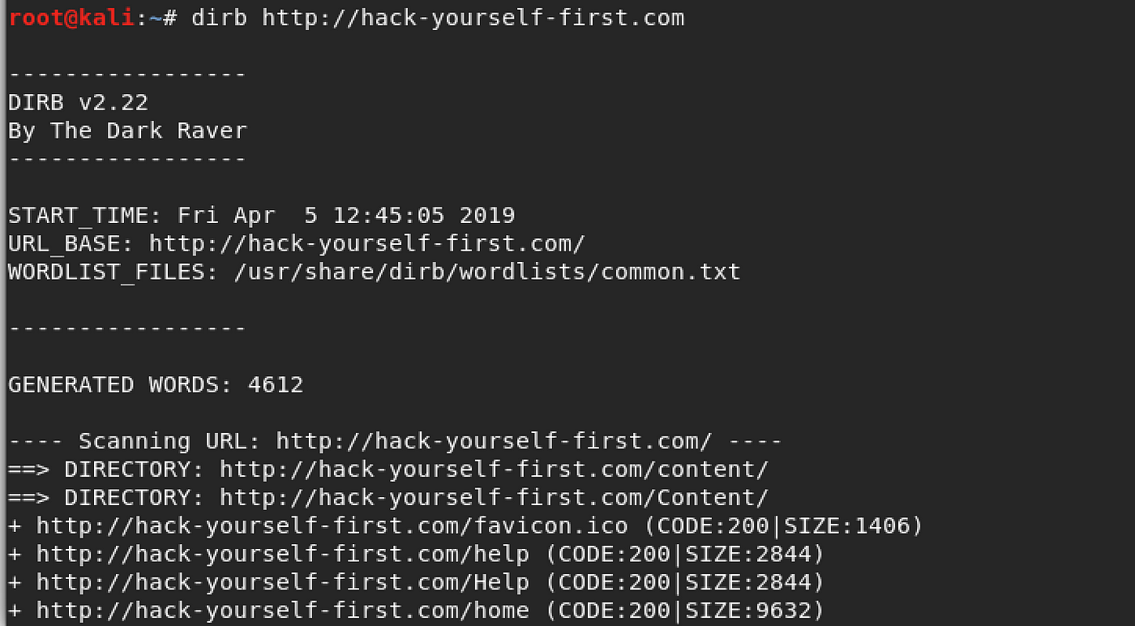
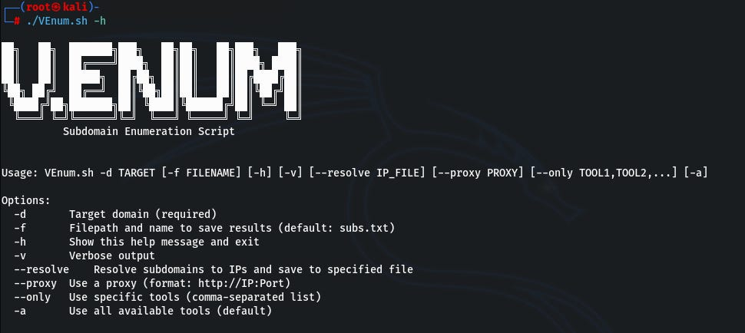
Software REQUIREMENTS
Terminal Application Code: - Developed using Python 3. - Well-organized, well-commented, and following best coding practices.
Test Environments: - Set up a test website with known vulnerabilities for testing. - Test cases covering various vulnerabilities, URLs, open ports, SSL issues, etc.
Security Measures: - Implementation of measures to protect user data and ensure the security of the terminal application.
Error Handling and Logging: - Robust error handling mechanisms and logging to record any issues during vulnerability scans.

Slide 19
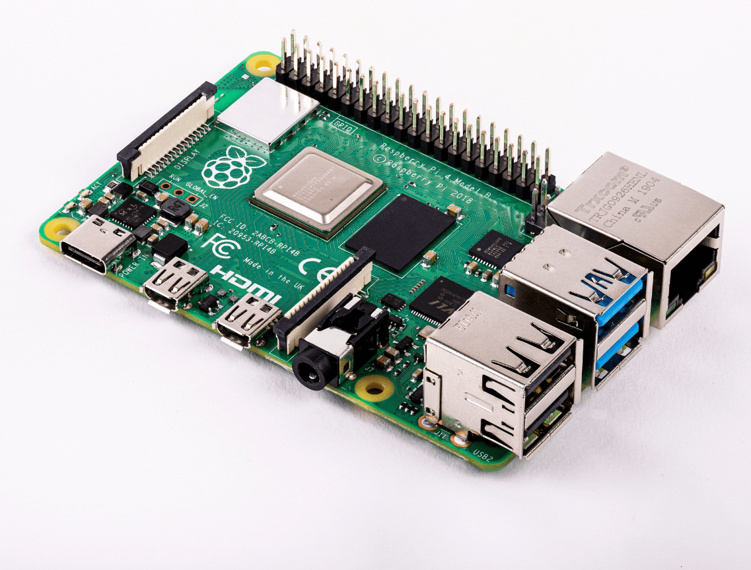
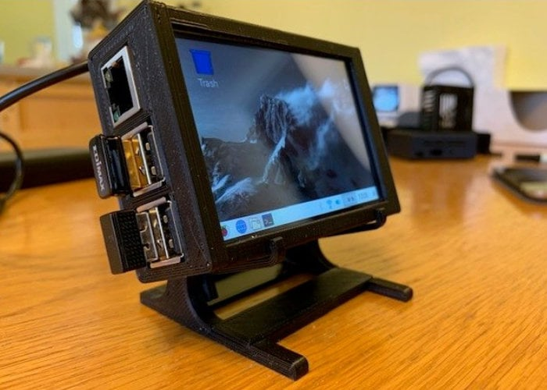
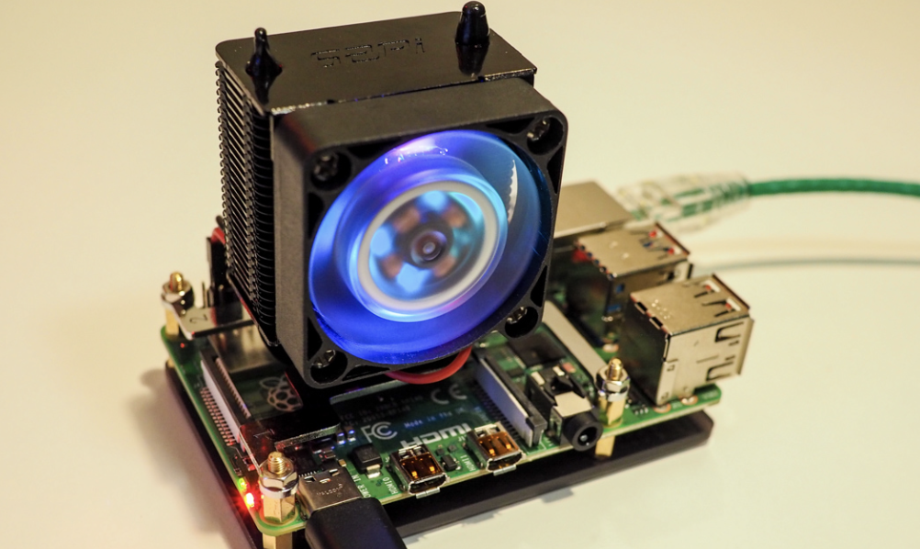
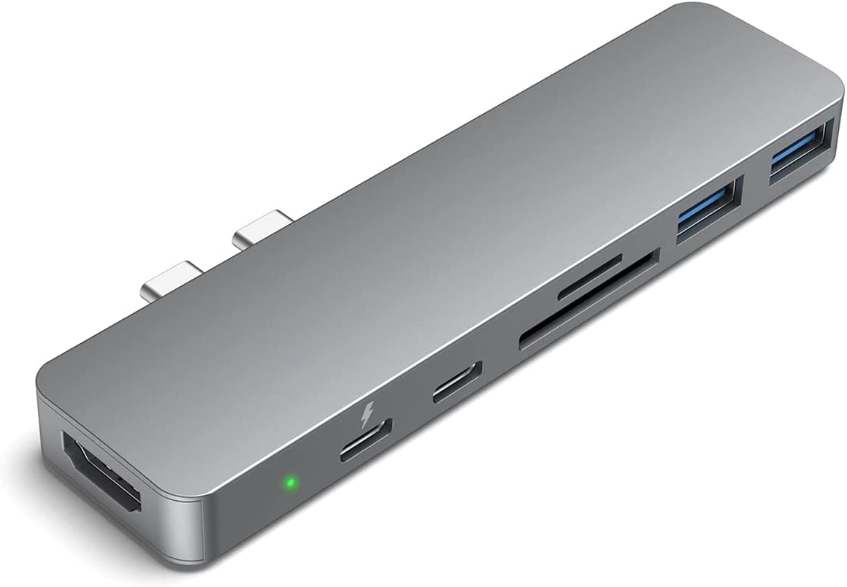
Hardware requirements
Raspberry Pi 4 (8GB RAM): - Core computing platform.
Display: - Waveshare 10.1 Inch Capacitive HDMI LCD with case (1280 x800)
Batteries: - Duracell Ultra Alkaline 9V Battery, 12 Pcs
Raspberry Pi Metal Aluminum Heatsink with Double Fans
24V/12V to 5V 5A Power Module DC-DC XY-3606 Power Converter
Jumper Wires: - 120 Pieces Male To Male, Female To Female, Male To Female Dupont Cable

Slide 20
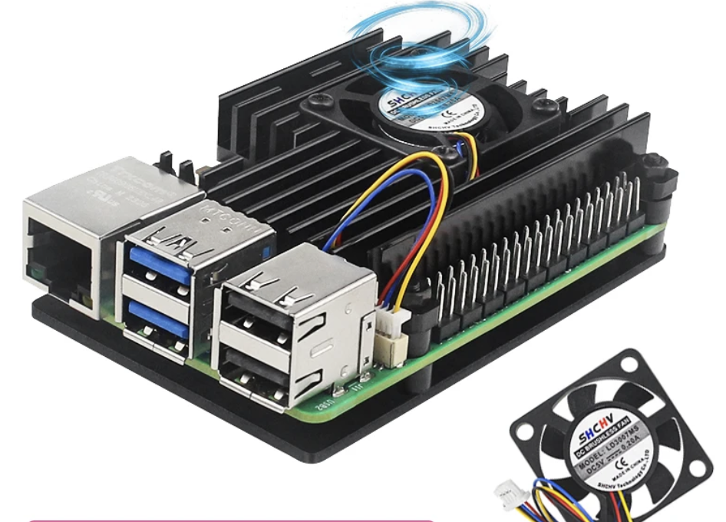
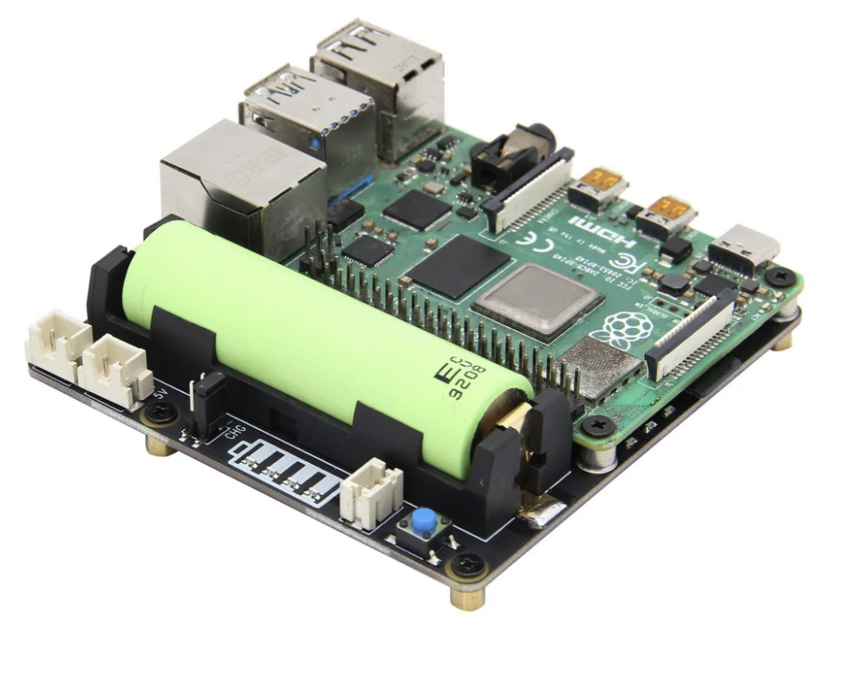
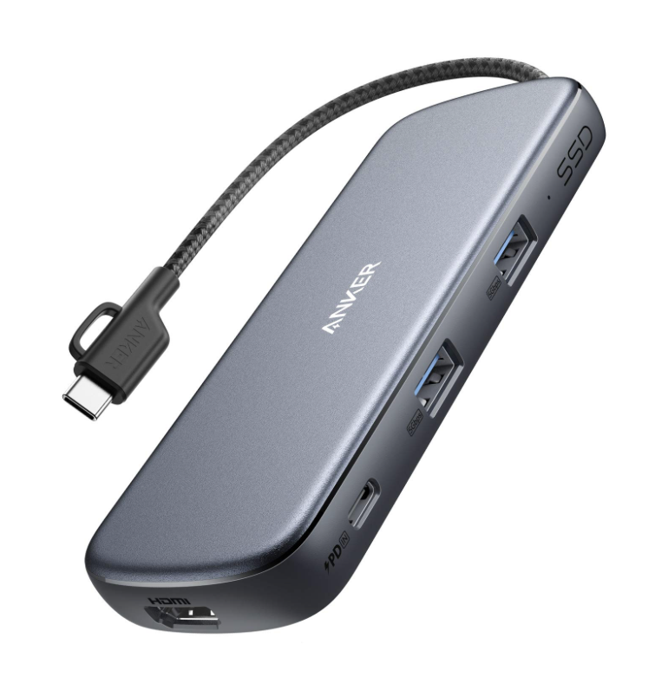
Hardware requirements
GeeekPi Aluminum Case with Official Raspberry Pi 5 Active Cooler for Raspberry Pi 5
Anker USB C Hub, PowerExpand+ 5 in 1 PD Hub, 1 x 4K HDMI, 2 x Type C PD Ports, 2 x USB 3.0 Ports, 100W PD Pass-Through Charging
Uninterrupted Power Supply (UPS): - Geekworm Raspberry Pi 4 UPS, X703 V1.2 18650 UPS Shield with Auto Power On Function for Raspberry Pi 5
SanDisk Extreme 128GB microSDXC UHS-I, V30, 190MB/s Read,90MB/s Write, Memory Card
SP Electron Vipow 3000mah 3.7v Lithium-Ion 18650 Rechargeable Battery (Pack of 6)

Slide 21
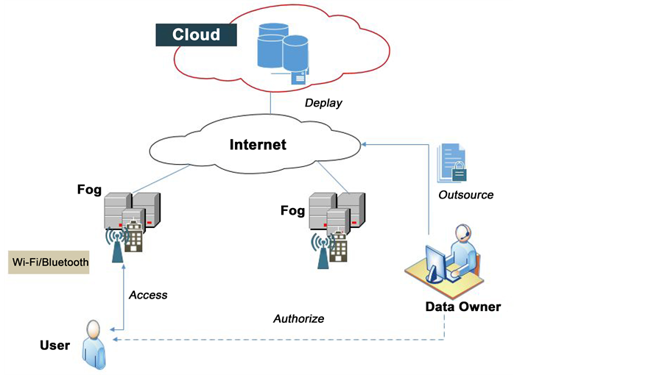
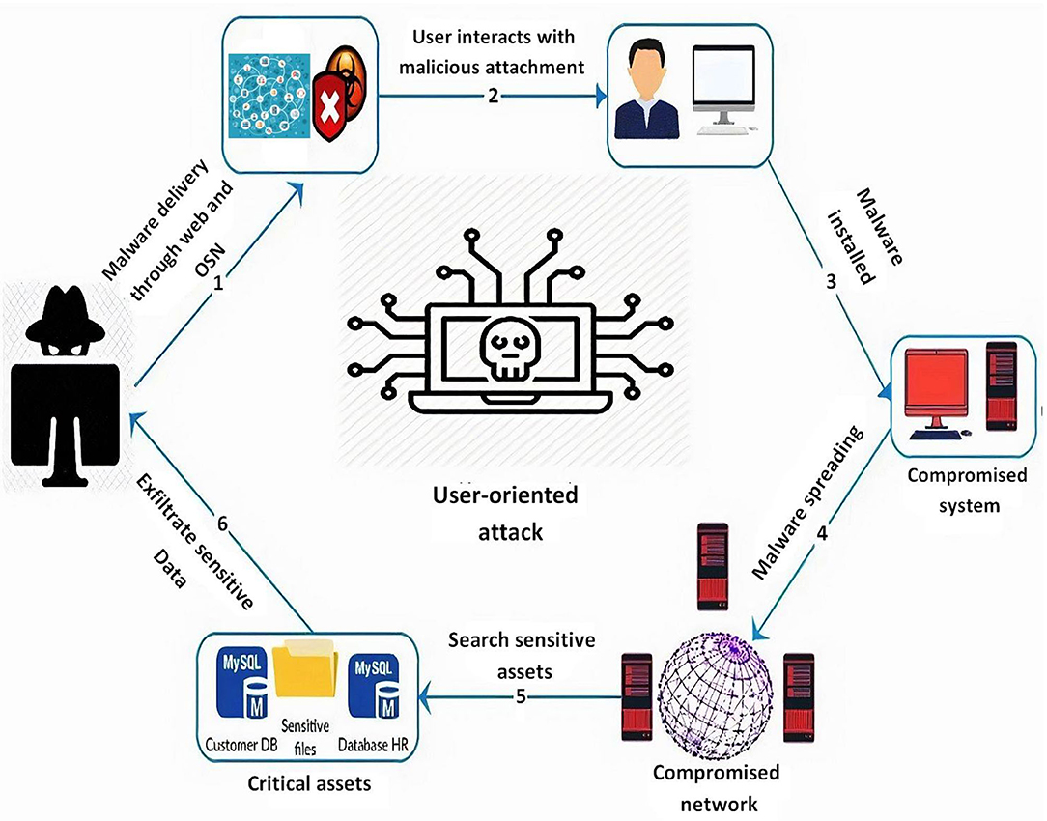
Conclusion :
Considering our project's specific requirements, the ideal choice emerges based on the balance of speed, coverage, and resource efficiency.
While Nmap and SSLyze excel in rapid assessments, Uniscan stands out for its comprehensive web vulnerability scanning. Depending on the project's emphasis—whether speed or depth—a tailored selection can be made.
The decision ultimately hinges on project priorities and resource constraints. It's recommended to conduct further testing in the project environment to validate the tools' performance under specific conditions.
The comprehensive timeline, ethical considerations, and detailed planning showcase the commitment to a successful and impactful outcome.

Slide 22
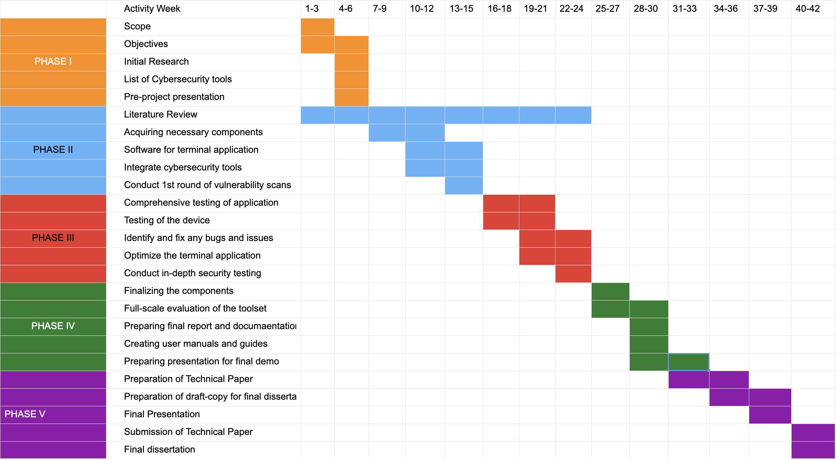
Project schedule

Slide 23
References :
Abdulqader, F. B., Thiyab, R. M., & Ali, A. M. (2017). The impact of SQL injection attacks on the security of databases. In Proceedings of the 6th International Conference on Computing and Informatics (pp. 323-331).
Kirti Randhe, "Security Engine for prevention of SQL Injection and CSS Attacks using Data Sanitization Technique", IJIRCCE, 2015.
J. Fonseca. Seixas, M. Vieira, and H. Madeira, "Analysis of Field Data on Web Security Vulnerabilities", IEEE Transaction on dependable and secure computing, vol. 11, no. 2, March/April 2014.
Jose Fonseca, Marco Vieira, and Henrique Madeira, "Evaluation of Web Security Mechanisms Using Vulnerability and Attack Injection", IEEE transaction on Dependable and secure compu-ting, Vol. 11, No. 5, 2014
Zoron Djuric, "Black Box Testing tool for Detecting SQL Injection Vulnerabilities", IEEE, 2013.
Abdul Razzaq, Khalid Latif, H.Farooq ahmad, Ali Hur, Zahid anwar and Peter Charles Bloodsworth, "Semantic security against web application attacks", ACM, 2013.
Nilima R. Patil and Nitin N. Patil, April, 2012. "A comparative study of network vulnerability analysis using attack graph", in Proceedings of National Conference on Emerging Trends in Computer Technology (NCETCT-2012).
Peng Li and Baojiang Cui, December, 2010, "A Comparative Study on Software Vulnerability Static Analysis Techniques and Tools", in Proceedings of the IEEE International Conference on Information Theory and Information Security (ICITIS), pp.521-524.
Nilsson J., 2006, "Vulnerability Scanners", Master of Science Thesis at Department of Computer and System Sciences, Royal Institute of Technology, Kista, Sweden
H.S. Venter, J.H.P. Eloff, (2004), Vulnerability forecasting -a conceptual model, University of Pretoria, SA, Department of Computer Science.
Oleg Sheyner, Joshua Haines, Somesh Jha, R. Lippman and J. M. Wing, May, 2002. "Automat-ed generation and analysis of attack graphs", in Proceedings of IEEE Symposium on Security and Privacy.

